Slide 1
Using CNTK to Win the Computational Intelligence in Forecasting International Time Series Competition
Slawek Smyl
August 2016

Slide 2
Agenda
The CIF competition
Recurrent NNs, LSTM
My submissions
Summary
Processing and learning details

Slide 3
Computational Intelligence in Forecasting Time Series Competitions
Its second edition, first one in 2015. Its goal: to attract researches from Computational Intelligence disciplines (and especially Fuzzy Logic, the research specialty of the organizers ☺) into forecasting
One of the two regularly occurring time series competitions, the other one is Global Energy Forecasting competition (every two years).
This kind of scientific competitions has become more popular; the recent IEEE World Congress of Computational Intelligence hosted 9 other competitions, e.g. Multiobjective Optimization Competition. MSR won a high-profile ImageNet competition last year.
The CIF motto: “If it works only in your paper, it does not work!"

Slide 4
Methods Allowed
From http://irafm.osu.cz/cif
“The prediction competition is open to all methods of computational intelligence, incl. fuzzy method, artificial neural networks, evolutionary algorithms, decision & regression tress, support vector machines, hybrid approaches etc. used in all areas of forecasting, prediction & time series analysis, etc.
Ensemble techniques are also allowed, if they employ any CI method.

Slide 5
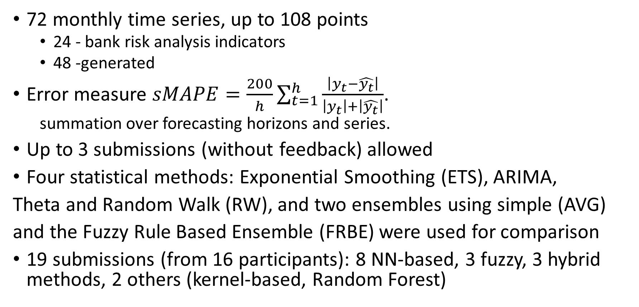
CIF 2016
72 monthly time series, up to 108 points
24 - bank risk analysis indicators
48 -generated
Error measure $sMAPE=\frac{200}{h}\sum_{t=1}^{h}{\frac{\left|y_{t}−\hat{y_{t}}\right|}{\left|y_{t}\right|+\left|\hat{y_{t}}\right|}}$.
summation over forecasting horizons and series.
Up to 3 submissions (without feedback) allowed
Four statistical methods: Exponential Smoothing (ETS), ARIMA,
Theta and Random Walk (RW), and two ensembles using simple (AVG)
and the Fuzzy Rule Based Ensemble (FRBE) were used for comparison
19 submissions (from 16 participants): 8 NN-based, 3 fuzzy, 3 hybrid methods, 2 others (kernel-based, Random Forest)

Slide 6
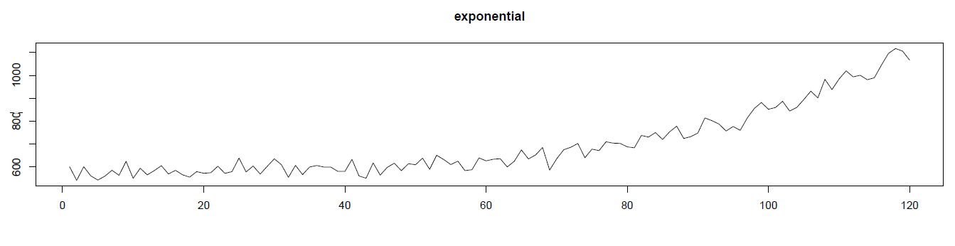
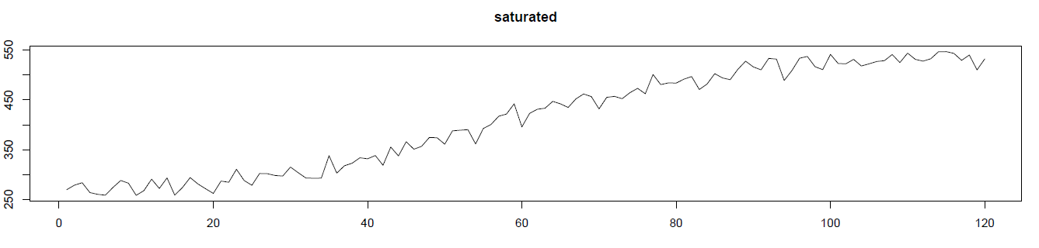
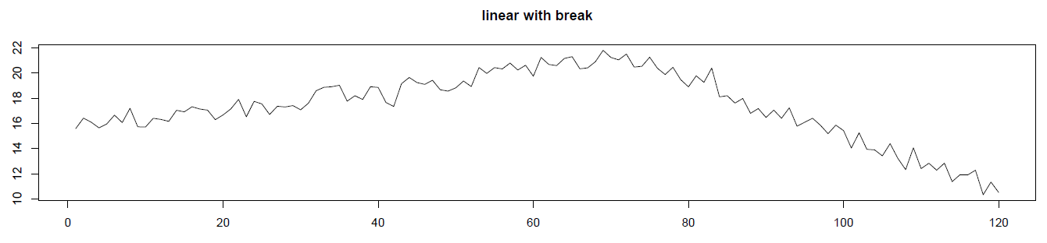
CIF 2016 Competition Data
The generated data was relatively nice, e.g.
Martin Štepnicka, Michal Burda – “CIF 2016” presentation

Slide 7
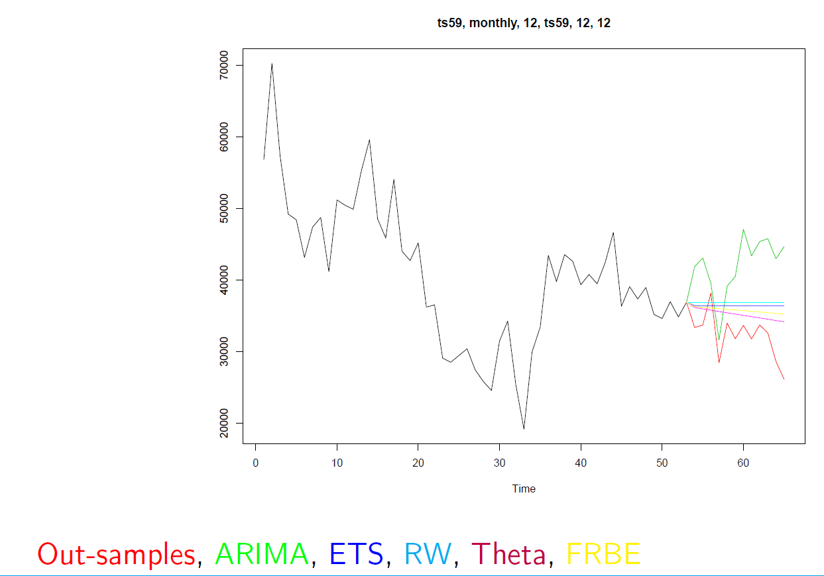
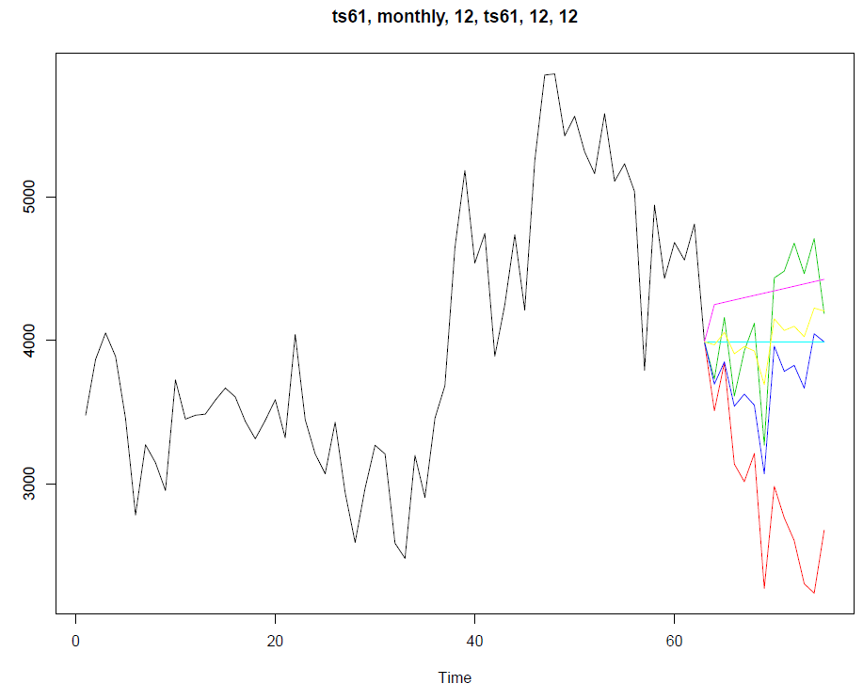
CIF 2016 Competition Data
The real, bank curves, were less nice ☺
Martin Štepnicka, Michal Burda – “CIF 2016” presentation

Slide 8
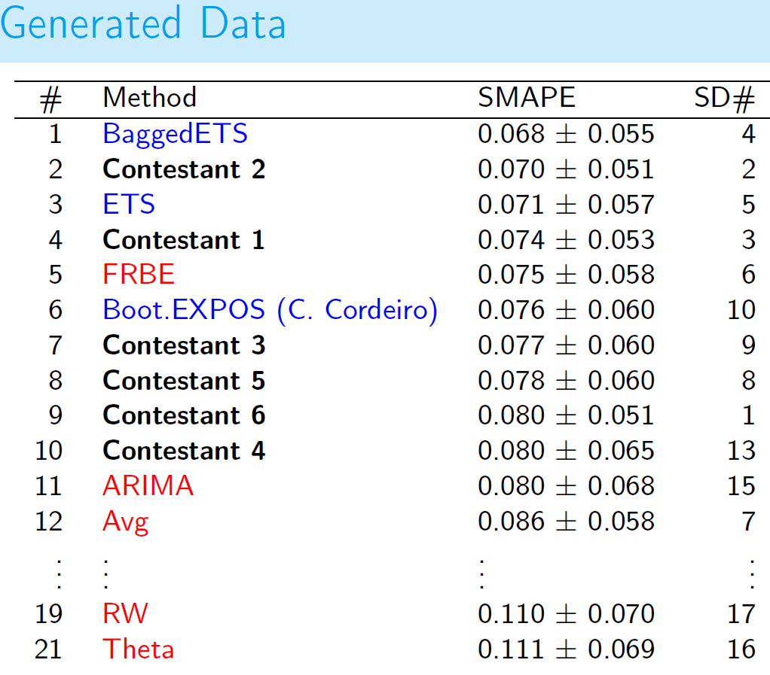
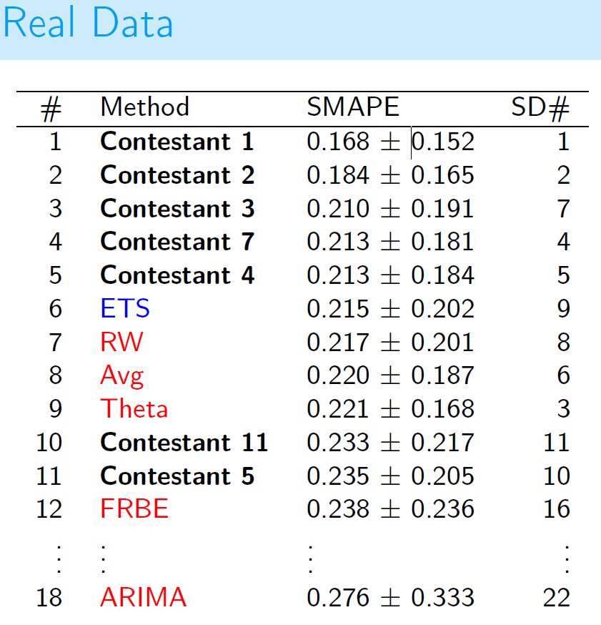
CIF Competition 2016 - Results
Standard time series algorithms did very well on the generated data. On the real data, some Computational Intelligence methods were better.
Martin Štepnicka, Michal Burda – “CIF 2016” presentation

Slide 9
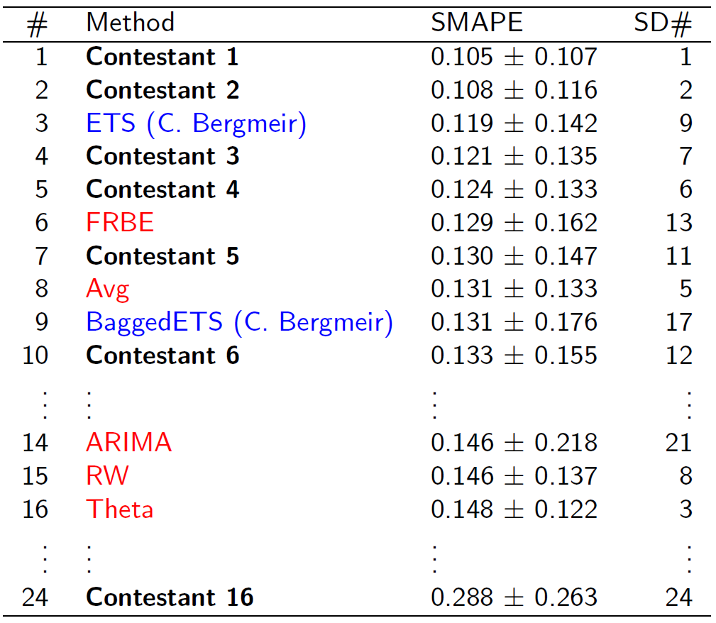
CIF Competition 2016 – Final Results
Contestant 1 – Slawek Smyl (LSTM-based NN on deseasonalized data)
Contestant 2 – Slawek Smyl (weighted average of my 3 methods)
Contestant 3 – prof. Sven Crone (Multilayer Perceptron with a thorough feature search)
Contestant 4 - Mikhail Artyukhov (previous competition winner, ensemble models)
Contestant 5 - Joerg Wichard, Bayer Healthcare AG (Adaptive Forecasting Strategy with Hybrid Ensemble Models)
Contestant 6 – Slawek Smyl (LSTM-based NN)
Martin Štepnicka, Michal Burda – “CIF 2016” presentation

Slide 10
My submissions
Submission 1, LSTM (Contestant 6):
LSTM-based NN with minimal preprocessing
Submission 2, LSTM_deseason (Contestant 1):
LSTM-based NN operating on deseasonalized data
Submission 3 (Contestant 2):
0.25*LSTM+0.4*LSTM_deseason+0.35*LPT
If I had not been scared of disqualification (these were supposed to be Computational Intelligence algorithms ☺), instead, I would have submitted:
0.4*LSTM_deseason+0.6*LPT
… and I would have probably won with bigger margin (based on back testing)
LPT is variation of LGT method, which is described in detail in http://msanalytics/mp/Research/MSJAR_Volume_5.pdf

Slide 11
Recurrent Neural Network for Time Series Forecasting
Recurrent NN have directed cycles, therefore they can “remember” something about past values – they have a state
Typically a moving window is used for feature extraction, and so what is outside the window has no influence on the result/learning. But in case of RNN there is a hope that the state will hold part of this no-longer-visible information.
RNNs can be trained across many time series, but then during the prediction stage, when fed data step-by-step from one series, can “zero-in” on this particular series. So we can learn across series, but individualize the response.
ML algorithms, like Random Forest, do not have an internal state, all input information must be encoded and presented at once.
Unfortunately, RNNs, like standard NNs, often performed below expectations on time series prediction tasks. One of the reasons: typically their memory is rather short (a few steps)

Slide 12
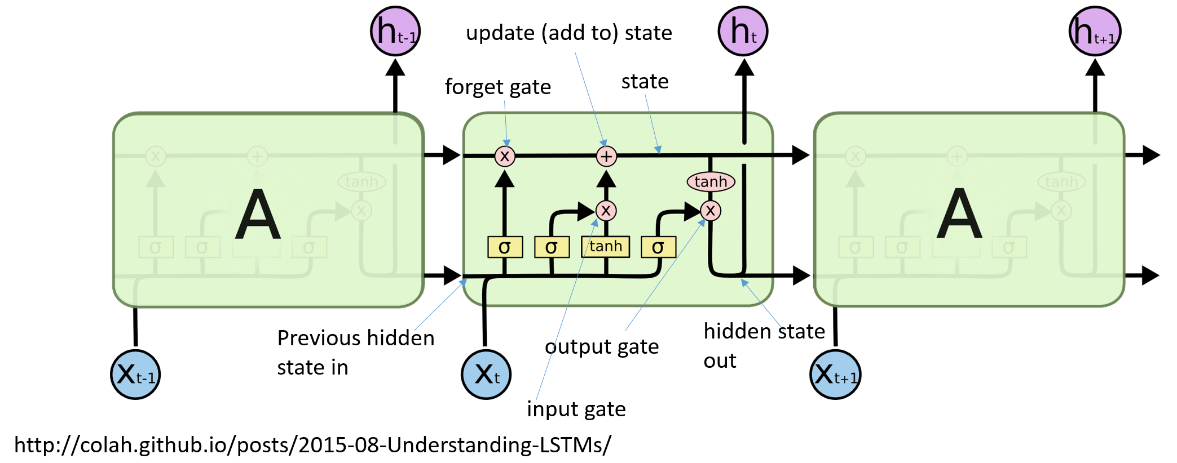
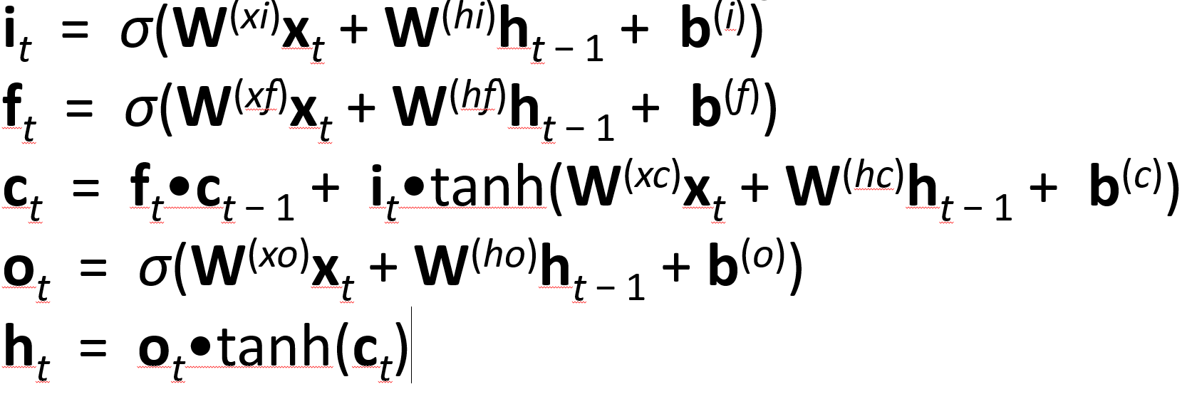
LSTM
Long Short-Term Memory is a type of recurrent neural network published in 1997 by Sepp Hochreiter and Jürgen Schmidhuber.
It holds state vector (actually two of them)
It has proved to be quite unique among RNN to be able to “remember” over 100 past steps.
A lot of recent progress in speech recognition and natural language processing came from using deep LSTMs.

Slide 13
Winning Submission (no 2): LSTM-based Neural Network Applied to Deseasonalized Data
It is a good solution, but nothing extraordinary. Apart from extraction of seasonality, it uses a very basic data preprocessing – rolling window and normalization. This was due to
relatively short length of the time series (max was 108 points)
lack of development time
hope the LSTM will compensate for the preprocessing shortcomings ☺
Generally, the best idea is to use an ensemble of a few good and diverse algorithms.
The whole solution is a bunch of R and CNTK scripts. Together with Paul Shealy we plan to add a bit simplified code as an example in DS VM. It also appears likely that Roopali Kaujalgi will make me to write a tutorial on Cortana Gallery web site. For the impatient, I can send the current scripts.

Slide 14
Architecture and Data Processing Used
Preprocessing (in R).
For each series:
Log(), then Stl() applied. Subtract the seasonal part.
Create a two adjacent moving windows: of inputSize, and max_forecast_horizon length respectively.
For each window: Normalize by subtracting the last value of input window from all other values in this window.
Training sets contains records from all time series (around 4000 records)
The network trained by minimizing Sum of Squares criterion.
Output: vector of max-forecast-horizon length
Denormalize , Reseasonalize
Standard hidden layer (no bias)
LSTM
NN
So, two systems
Input: 7 or 15 (for max-forecast-horizon 6 or 12 respectively)
Log(), Deseasonalize, normalize

Slide 15
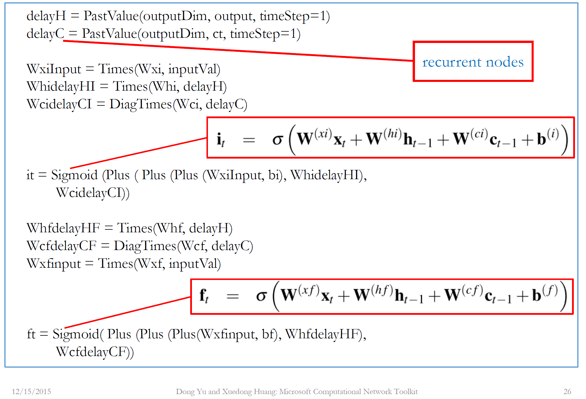
NN toolkit used - CNTK
Computational Network Toolkit
Open-source license since April 2015, on Linux and Windows https://github.com/Microsoft/CNTK
CNTK enables easy creation of new almost arbitrary models, including recurrent ones. In Probabilistic Programming fashion, it provides separation from model creation/description code and the learning code (which is automatically supplied)
It is scalable to from 1 to 8 GPUs per server and across several servers. It can also run just on CPU (using fast Intel MKL library). For large jobs with complicated NNs you can use https://philly

Slide 16
Questions/Further Work
How to create a NN architecture that would work well with seasonal data without statistical algorithms’ crutches? CNTK allows easy experimentation with novel architectures.
How to optimize NN architectures automatically? (Perhaps using evolutionary algorithms?) E.g. this architecture appear to work better when learning on hundreds of time series (M3 yearly data). Perhaps for even larger datasets the LSTMs could be stacked deeper?
Data augmentation. Neural networks have usually a lot of parameters (compared to the data set size). How to efficiently “fuzzify” data in a similar vain as in image processing area, where people “multiple” the data set size by rotating a bit the image, changing brightness, adding noise etc.
Output
Standard hidden layer
LSTM2
LSTM1
Inputs

Slide 17
Summary and Thanks (End of Part 1)
CNTK is a nice and powerful tool that allows easy experimentations with NN architectures.
Computational Intelligence methods may be substantially better than the standard statistical algorithms when dealing with “real” (i.e. not nice ☺) time series.
Preprocessing is crucial, statistical algorithms can be useful for it.
I would like to thank Frank Seide and Dong Yu for answering my several questions on CNTK during last few months.

Slide 18
Details
Warning: Detailed and graphical content follows. Participants’ discretion (i.e. preference for a lunch) is advised ☺

Slide 19
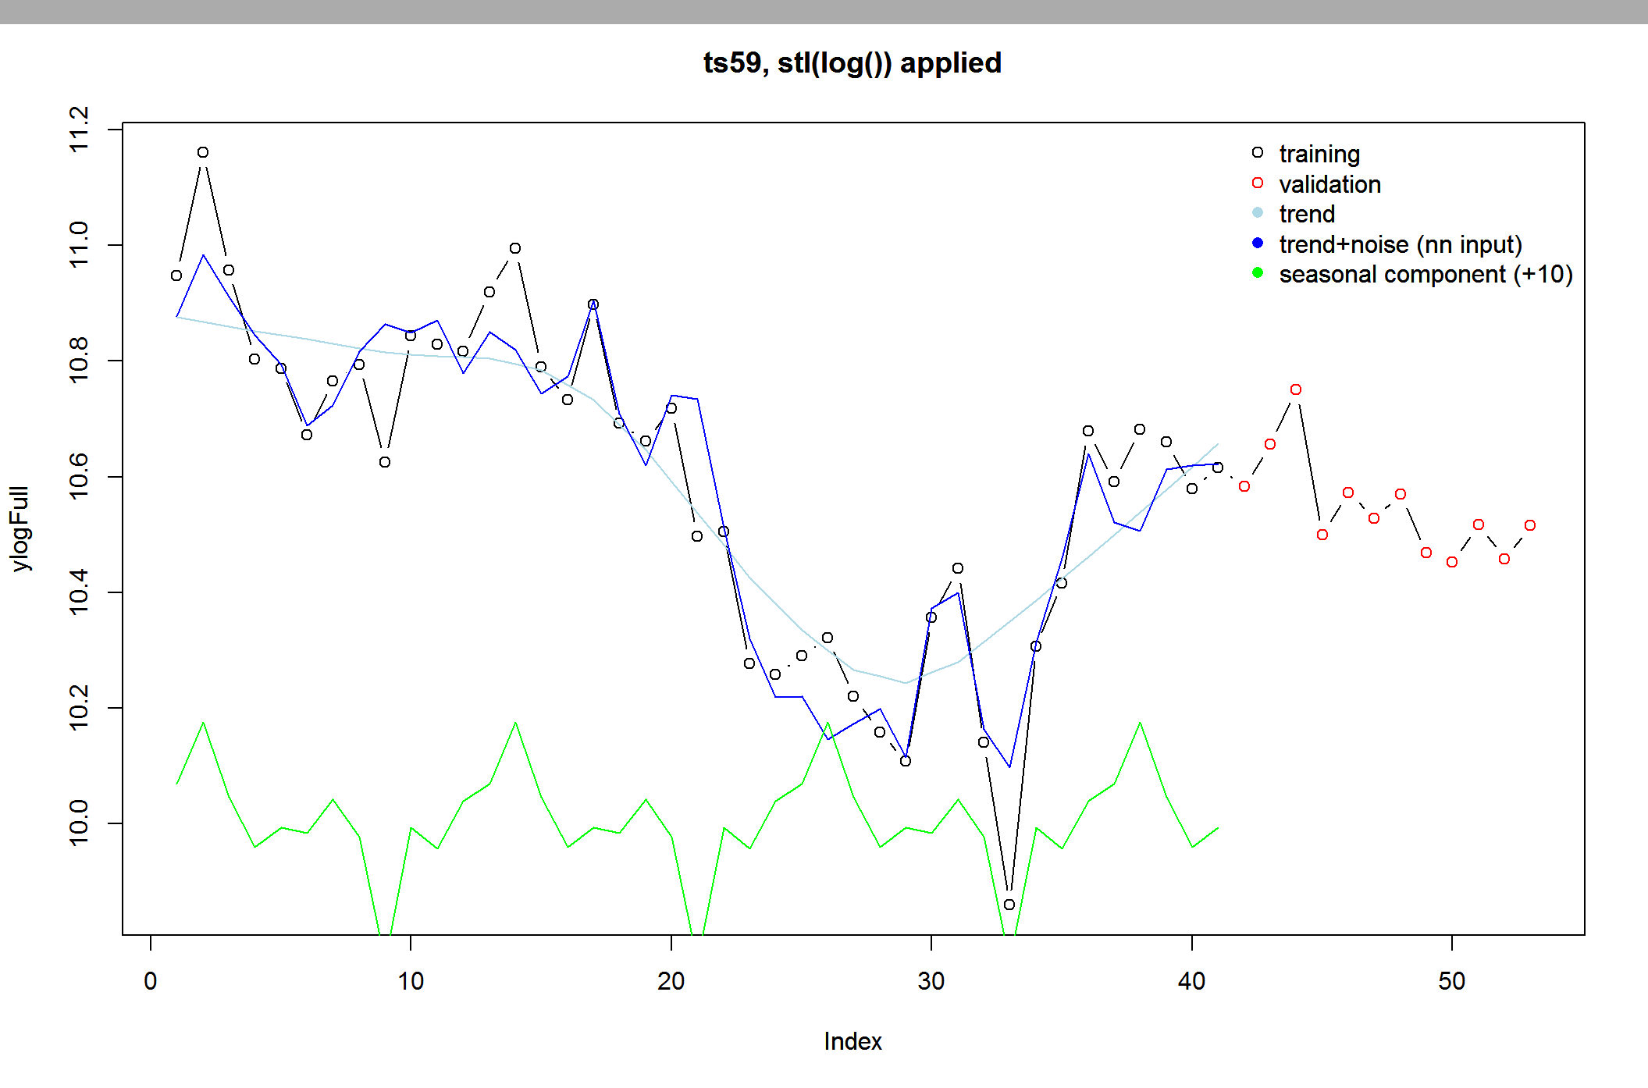
Data Preprocessing (1)

Slide 20
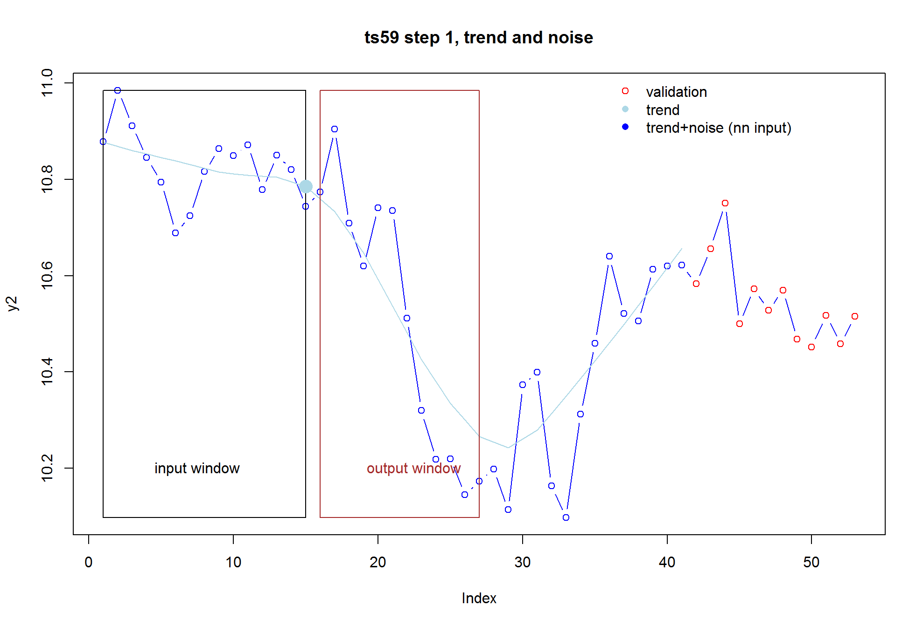
Data Preprocessing (2)

Slide 21
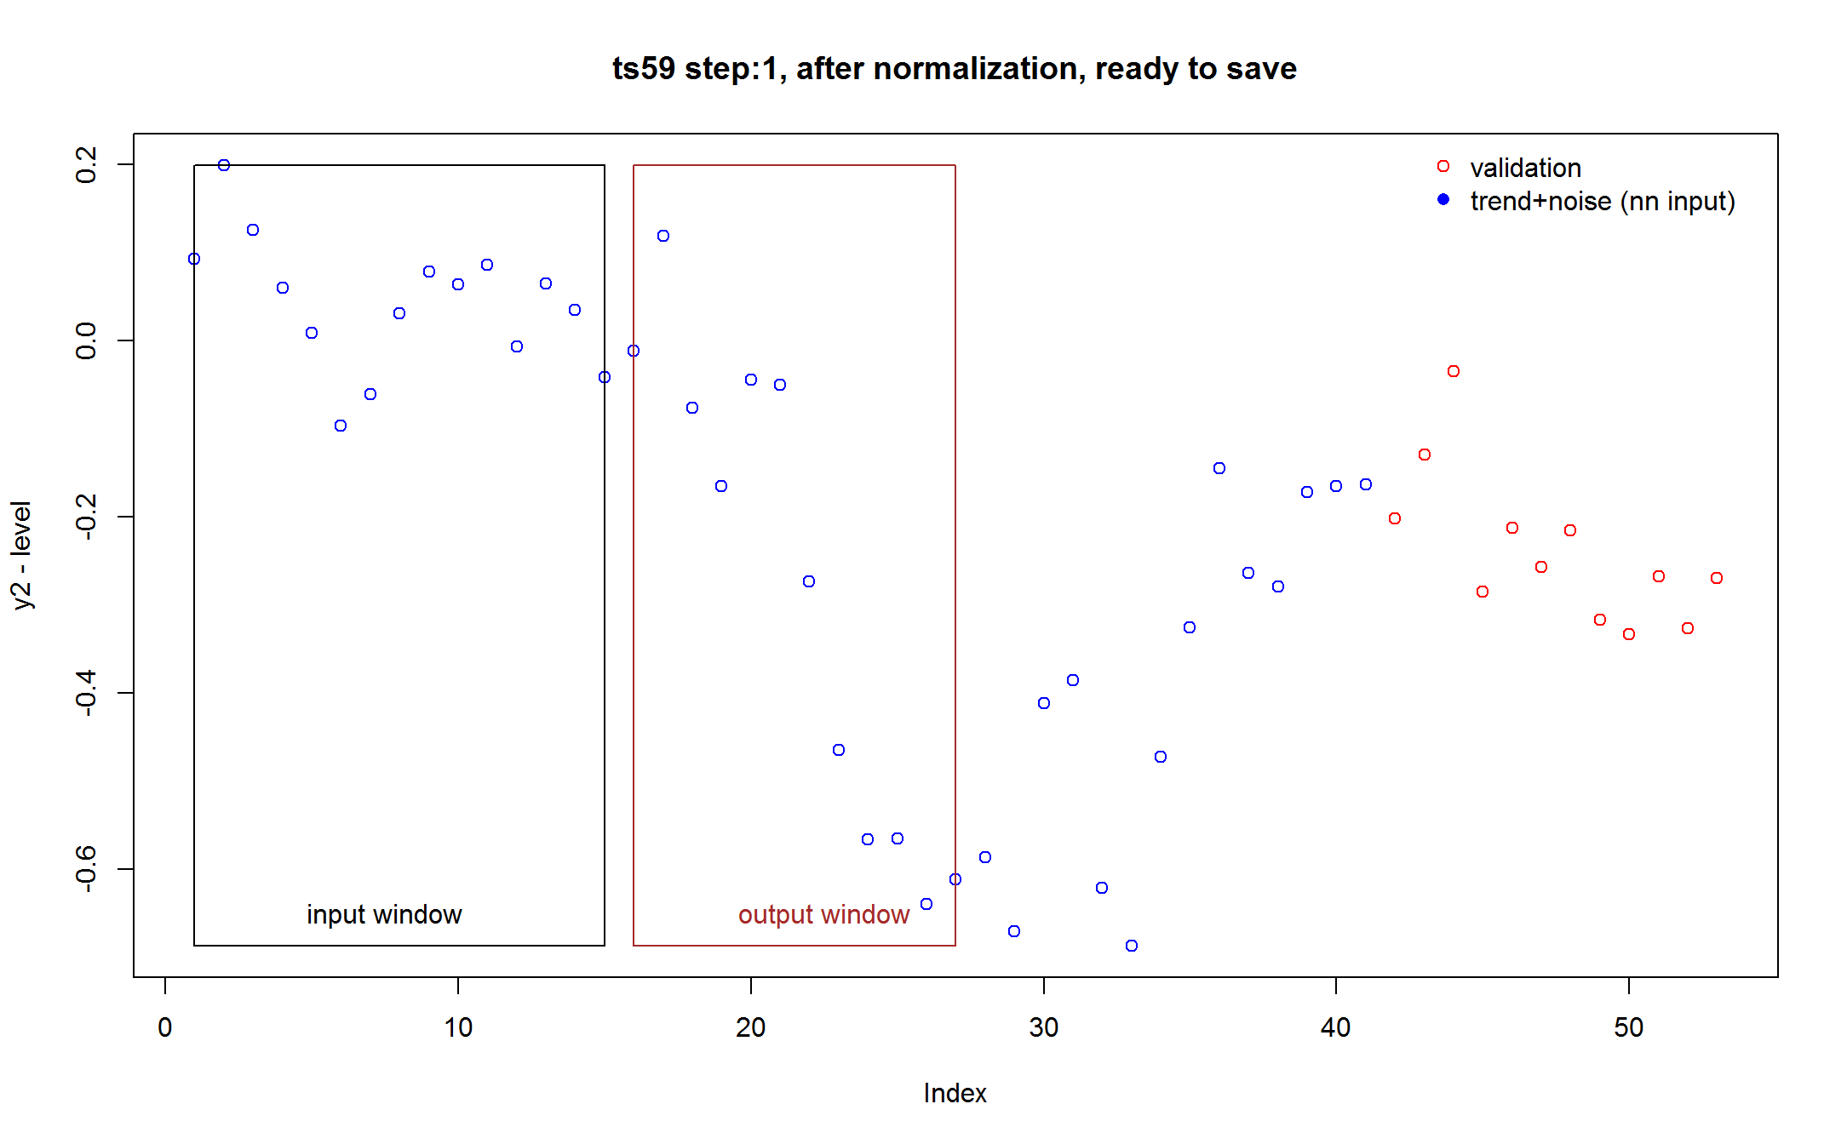
Data Preprocessing (3)
This is a simple data processing. Instead we could e.g.
Create several (perhaps overlapping) smaller output windows
2. Apply statistical algorithm on the time series (up to and including last input point) and extract some features (e.g. acf, ETS model types, ETS forecast)

Slide 22
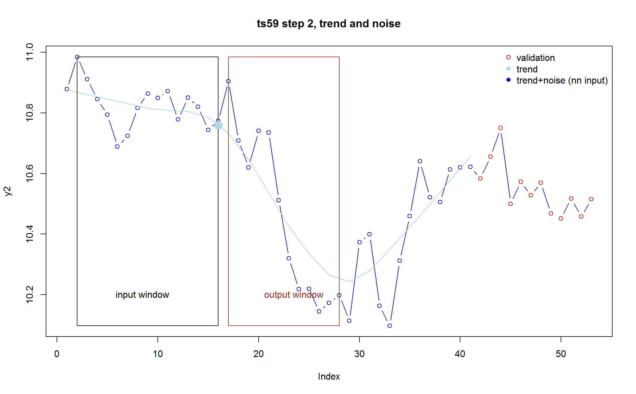
Data Preprocessing (4)

Slide 23
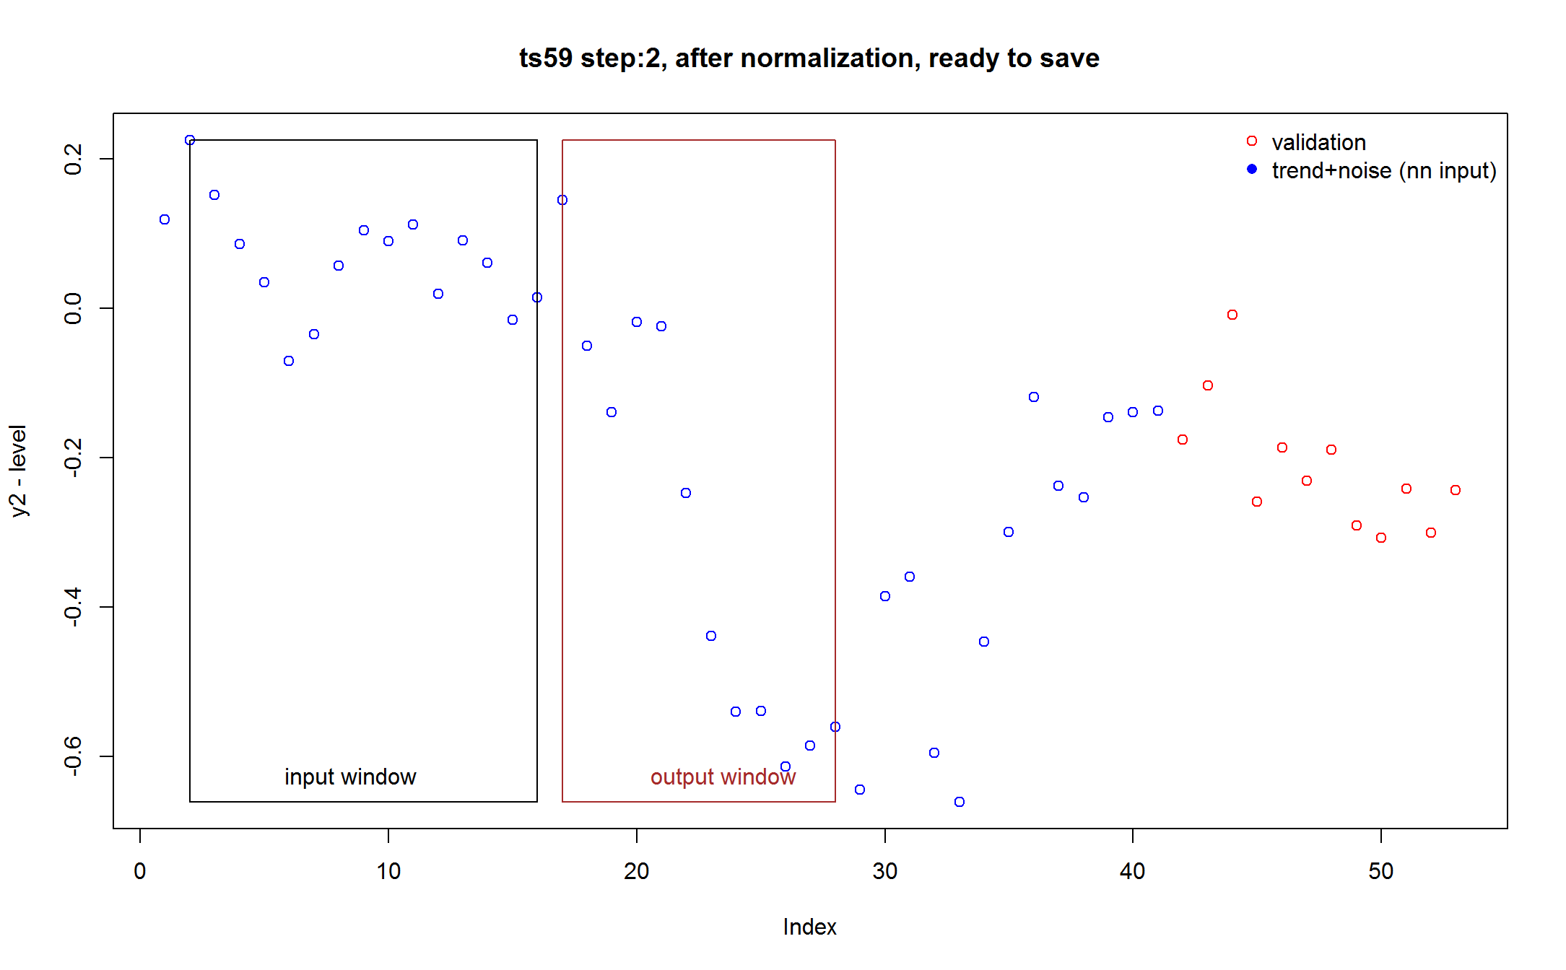
Data Preprocessing (5)
Etc., until the last point of output window becomes either last blue point for training or last red point for validation, respectively.

Slide 24
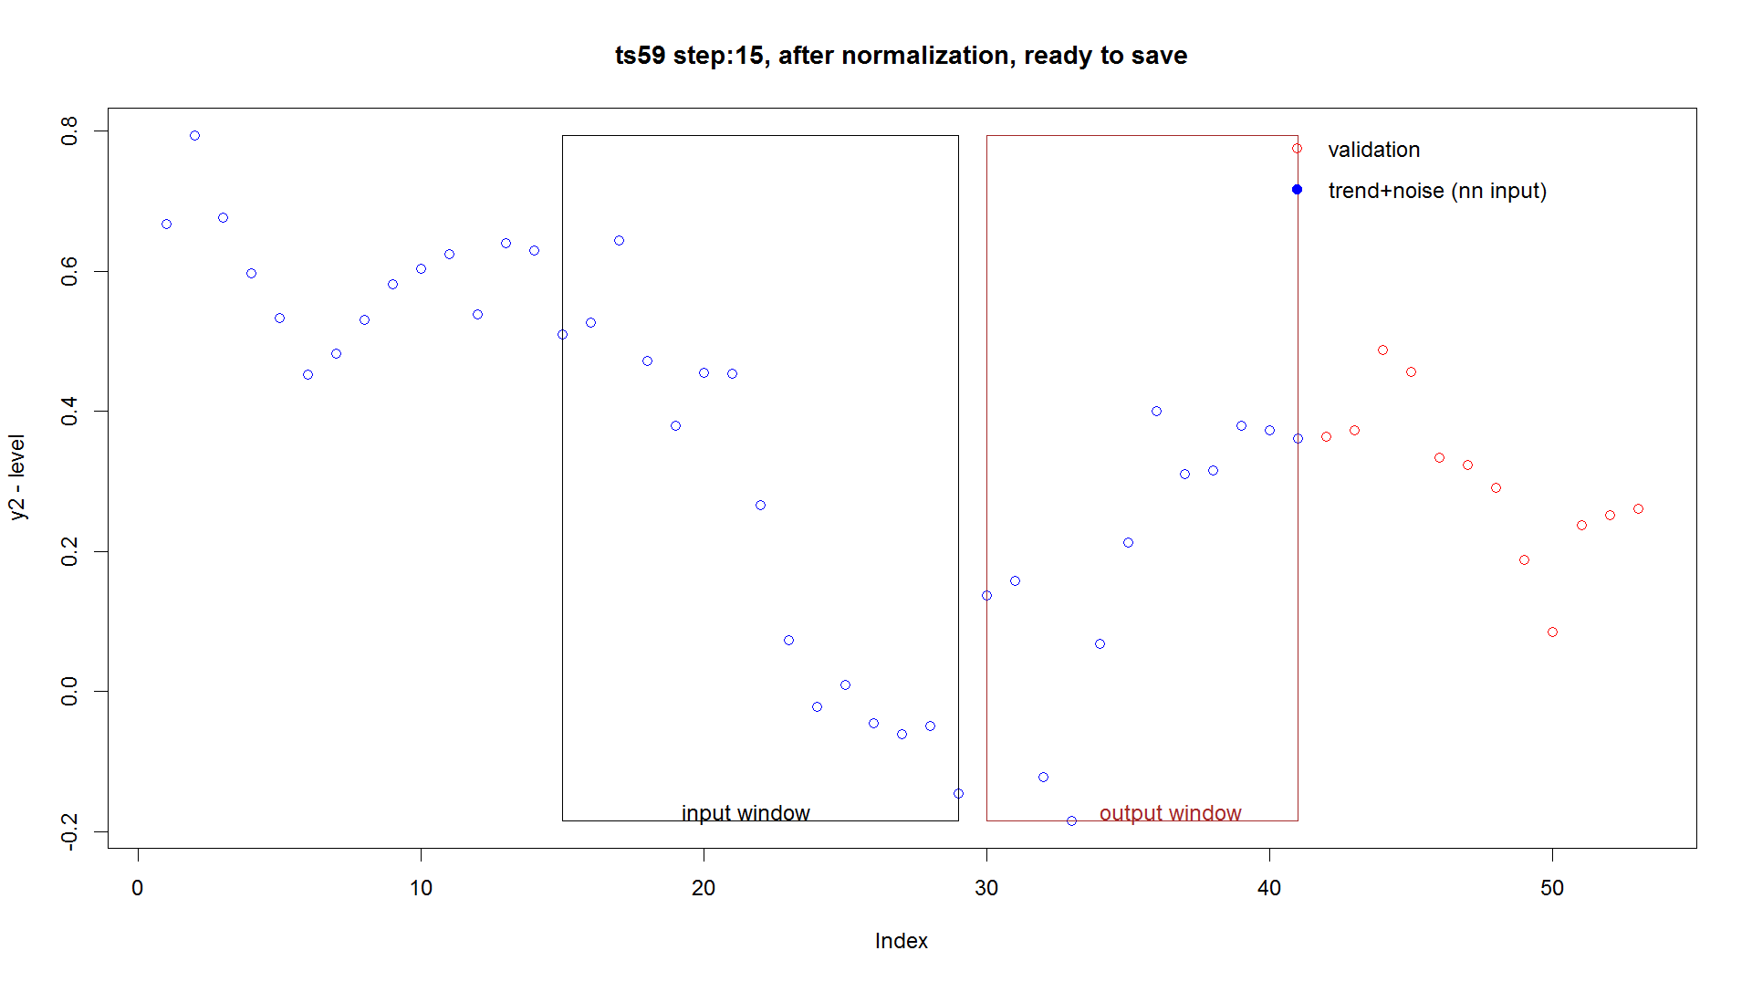
Data Preprocessing (6)
Last record in the training set (for this time series)

Slide 25
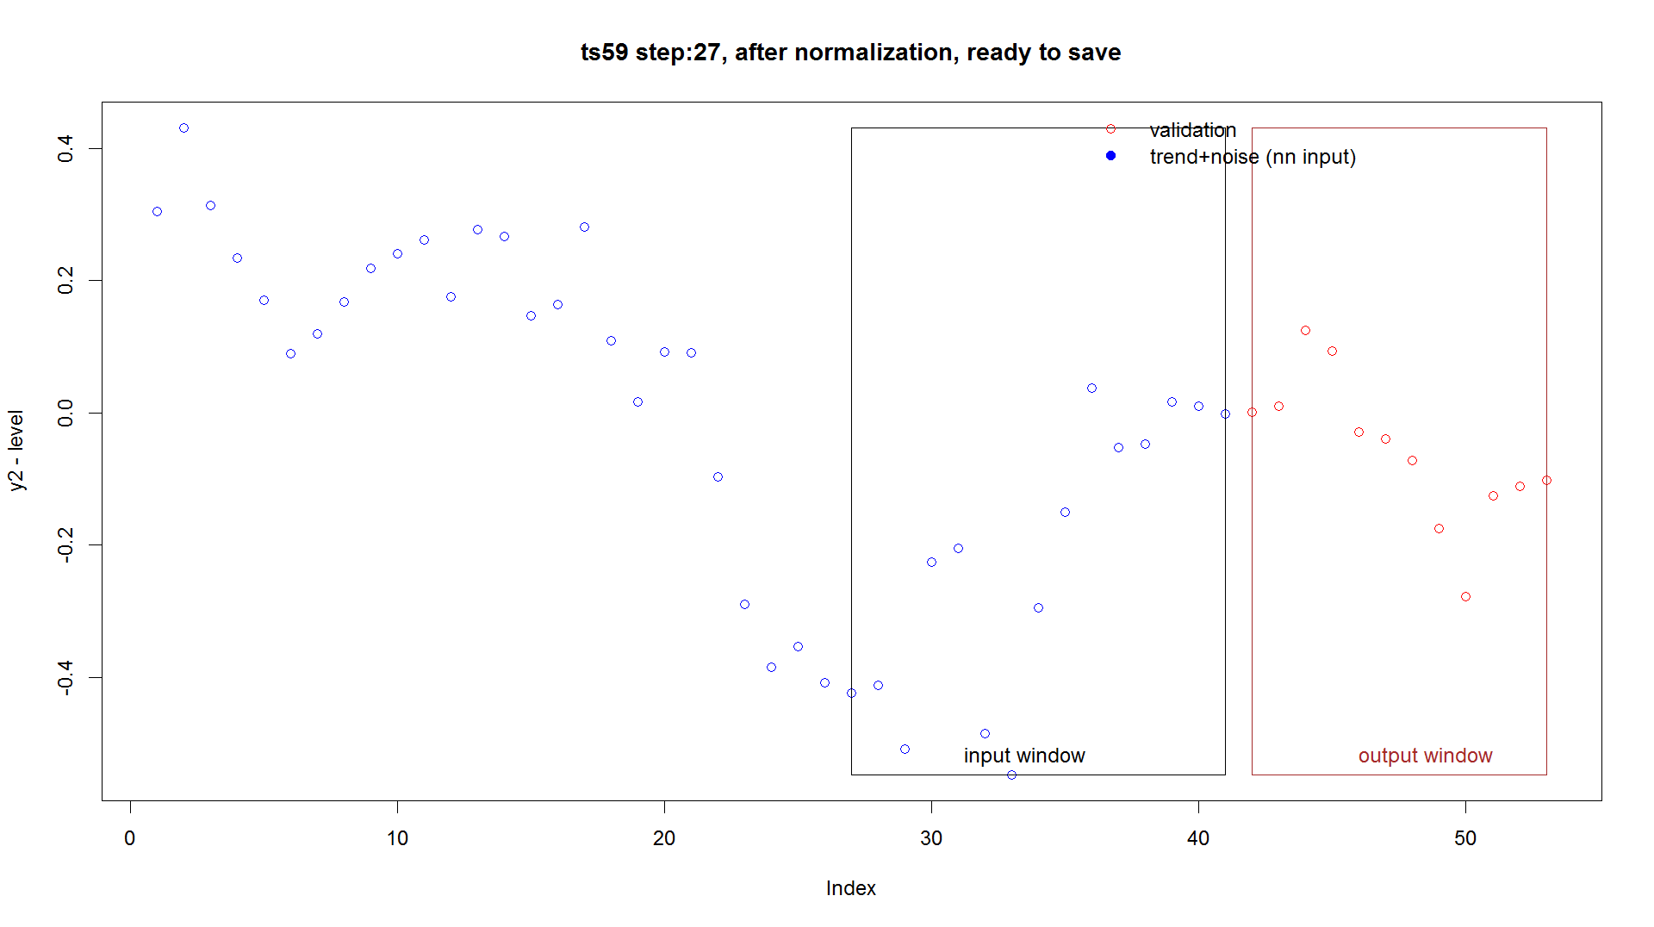
Data Preprocessing (7)
Last record (and only one used) in the validation set (for this time series)

Slide 26
Data Preprocessing (cont.)
Each time series is converted into length-inputSize-OutputSize records in case of the validation file, and length-inputSize-2*OutputSize records in case of the training file, here around 4000 records.
Although only the last record of each time series in the validation file is used for calculating the metrics, but all the records are needed, because it is an RNN, and we need to build the state by stepping from the beginning to the end of each series.

Slide 27
Training/Validation File in CNTK Text Format Reader format
...
59|i 0.09318115 0.1997686 0.1260745 0.05979146 0.008611811 -0.09614234 -0.060788 0.0313887 0.07853315 0.06421202 0.08654618 -0.006363943 0.06514452 0.03501314 -0.04102396 |o -0.01086625 0.11934681 -0.07640561 -0.1645973 -0.04419331 -0.04976314 -0.2732494 -0.4646733 -0.5661702 -0.5645416 -0.6393854 -0.6112202 |nyb 10.78478 -0.04073607 -0.006236446 -0.01631226 0.04200927 -0.02221759 -0.23828181 -0.005884322 -0.04288194 0.03898297 0.06973888 0.1756549 0.04616438
59|i 0.2257483 0.1520542 0.08577118 0.03459153 -0.07016262 -0.03480829 0.05736841 0.1045129 0.09019173 0.1125259 0.01961577 0.09112423 0.06099285 -0.01504424 0.01511346 |o 0.1453266 -0.050425891 -0.1386176 -0.01821359 -0.02378342 -0.2472697 -0.4386936 -0.5401905 -0.5385619 -0.6134056 -0.5852404 -0.5598146 |nyb 10.7588 -0.006236446 -0.01631226 0.04200927 -0.02221759 -0.2382818 -0.0058843221 -0.04288194 0.03898297 0.06973888 0.1756549 0.04616438 -0.04073607
…
The first value is sequence number; records of the same sequence need to be sequential ☺
|<inputAlias> marks beginning of new input vector, here |I for inputs, |o for outputs, and |nyb for a vector that will not be used for training (but will be used later in post processing in R)

Slide 28
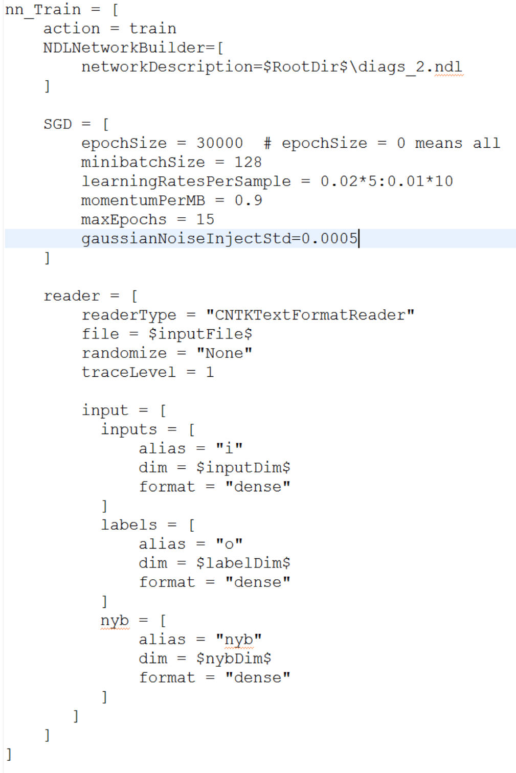
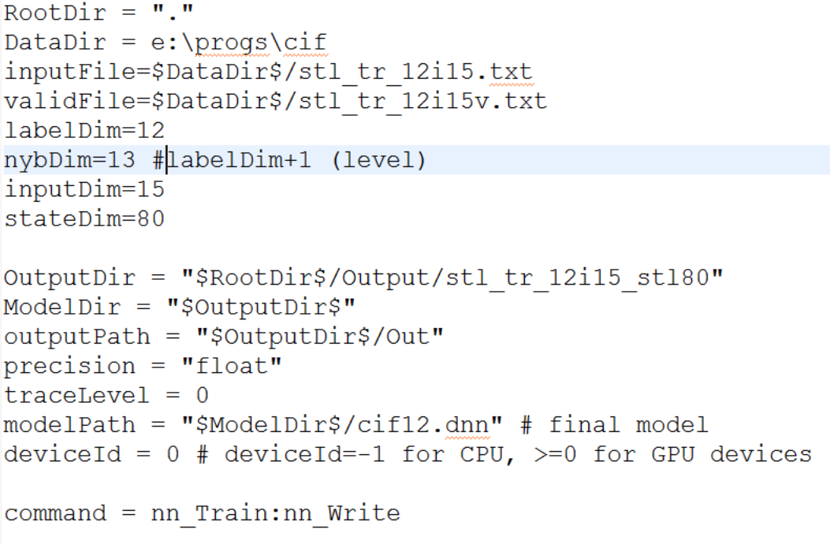
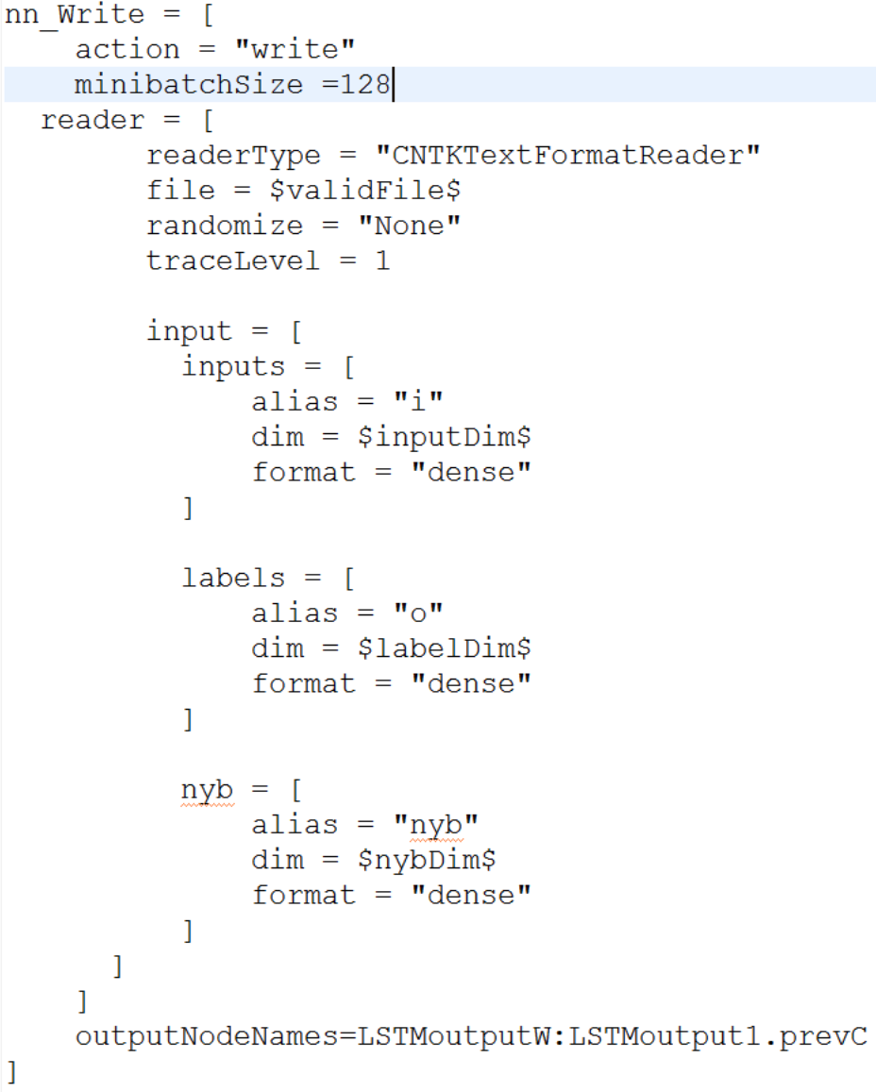
CNTK Configuration File

Slide 29
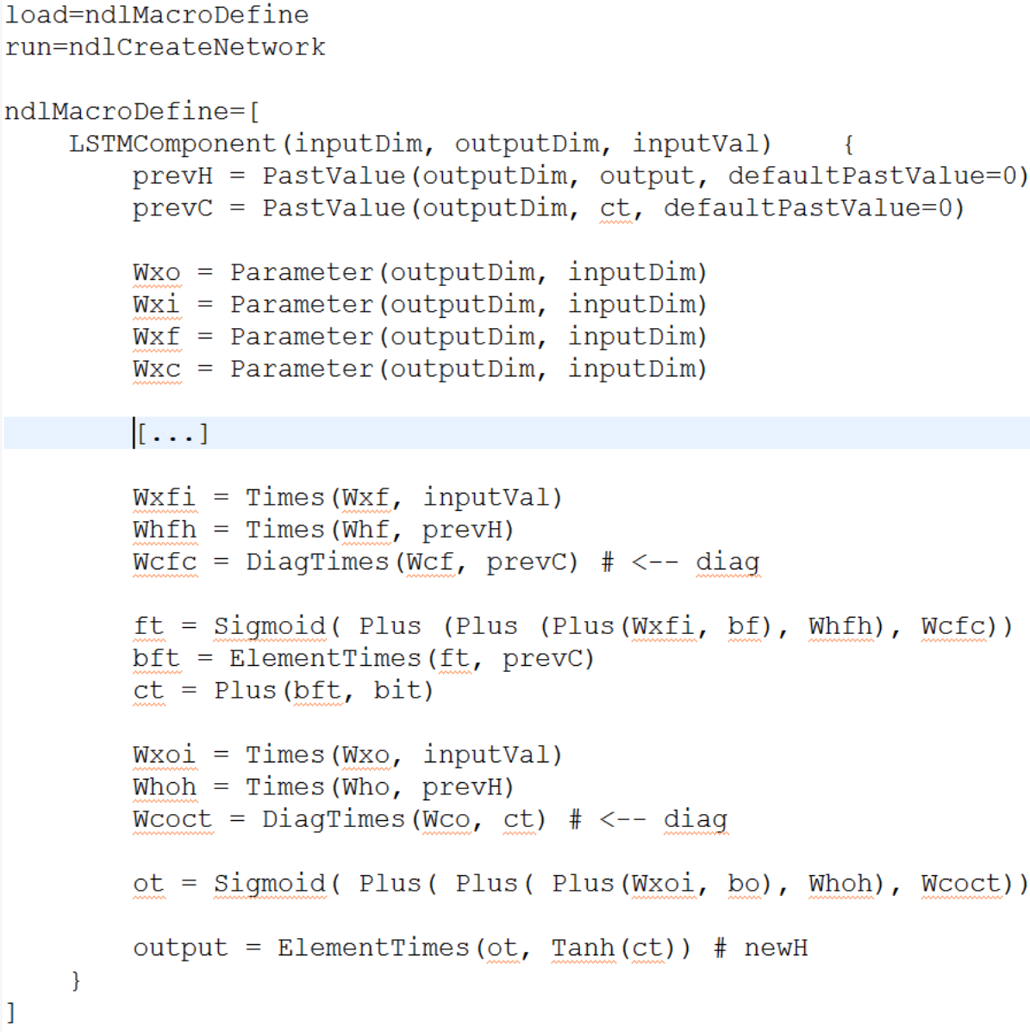
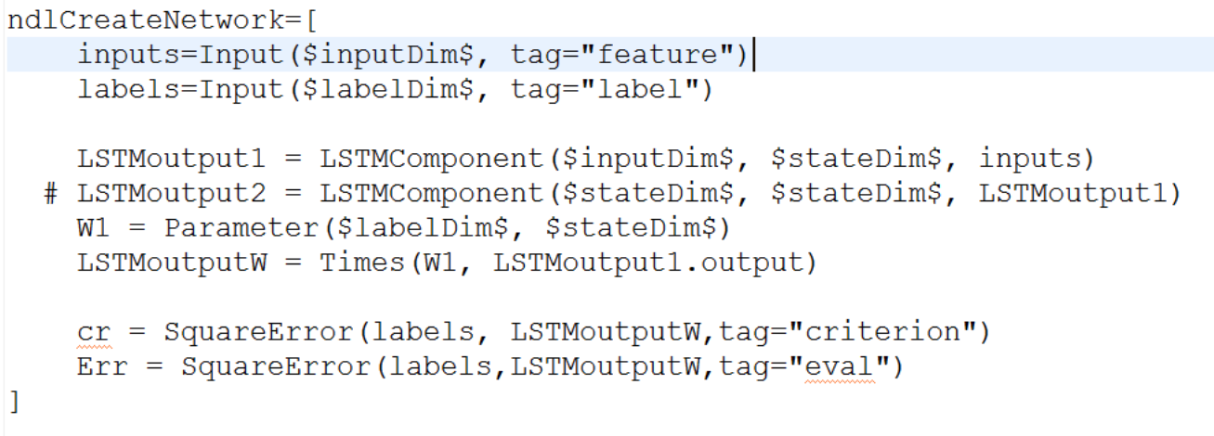
Network Definition File
NDL is almost deprecated, use BrainScript instead ☺

Slide 30
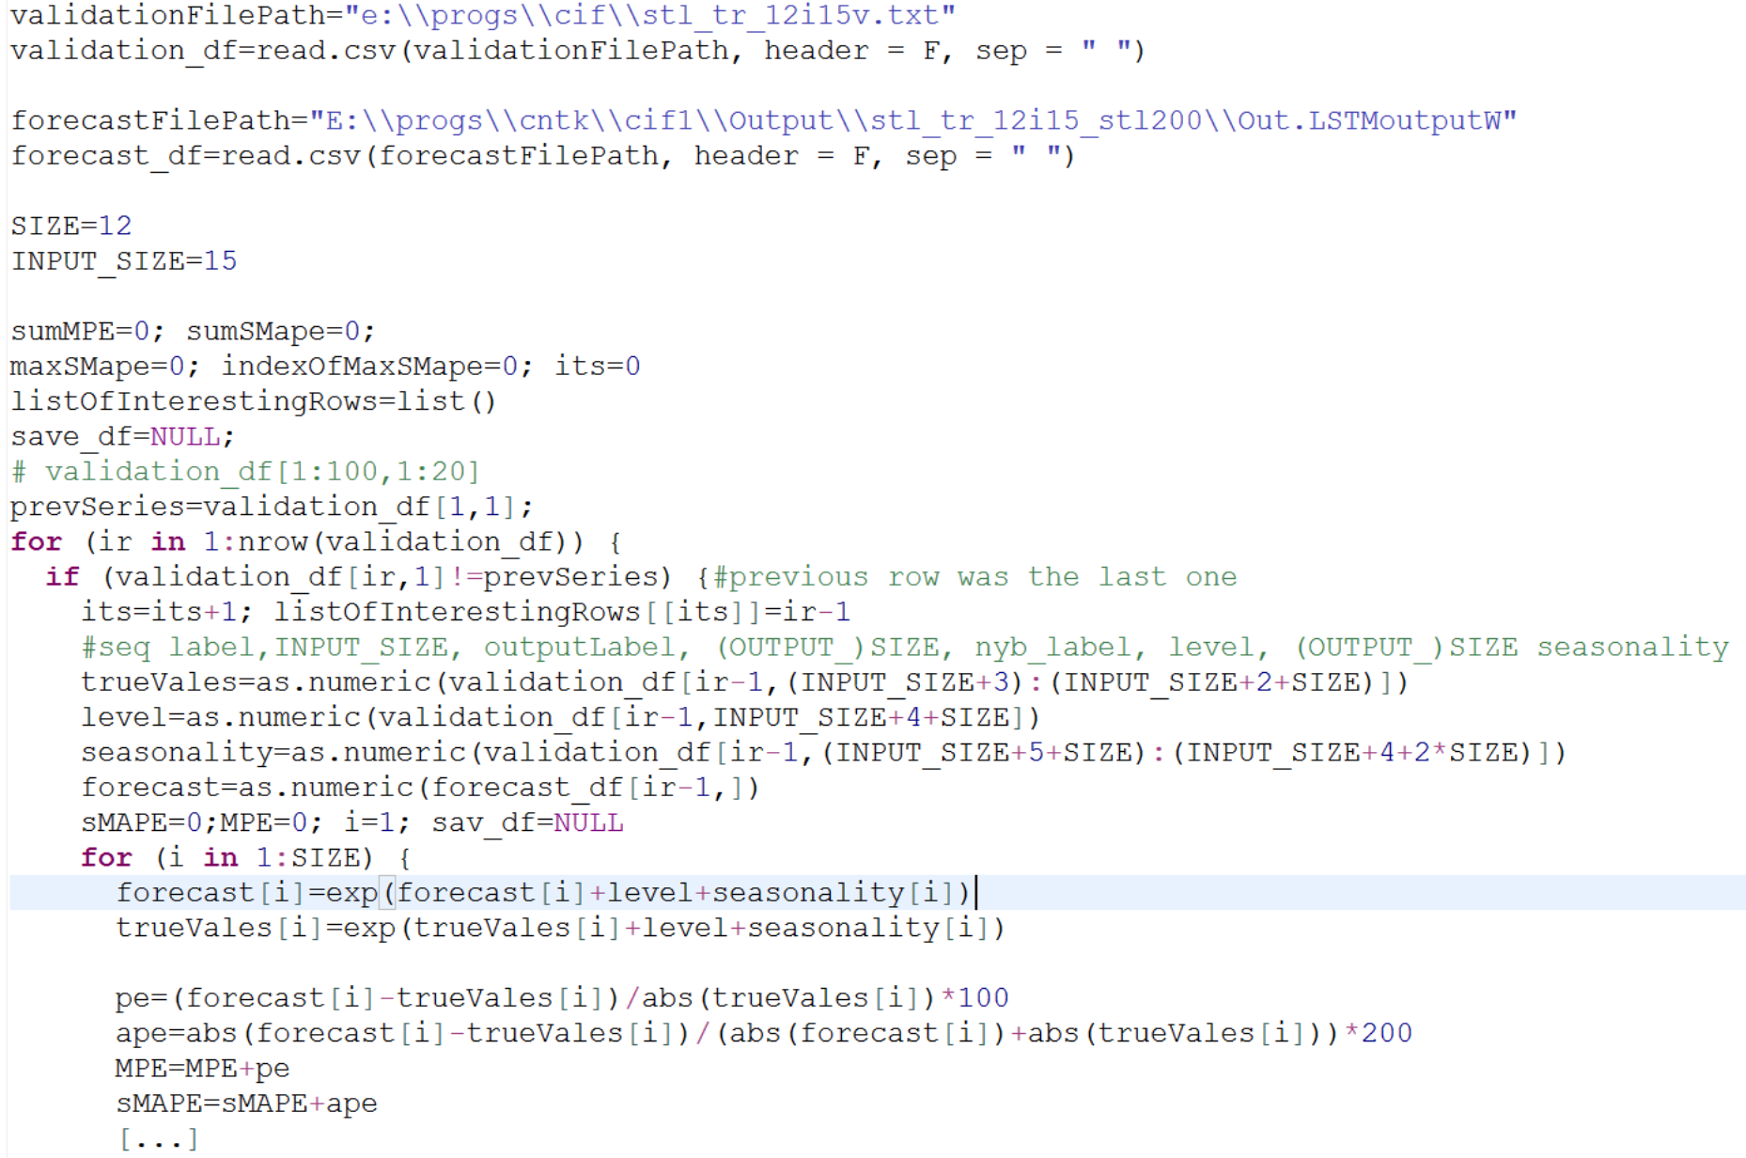
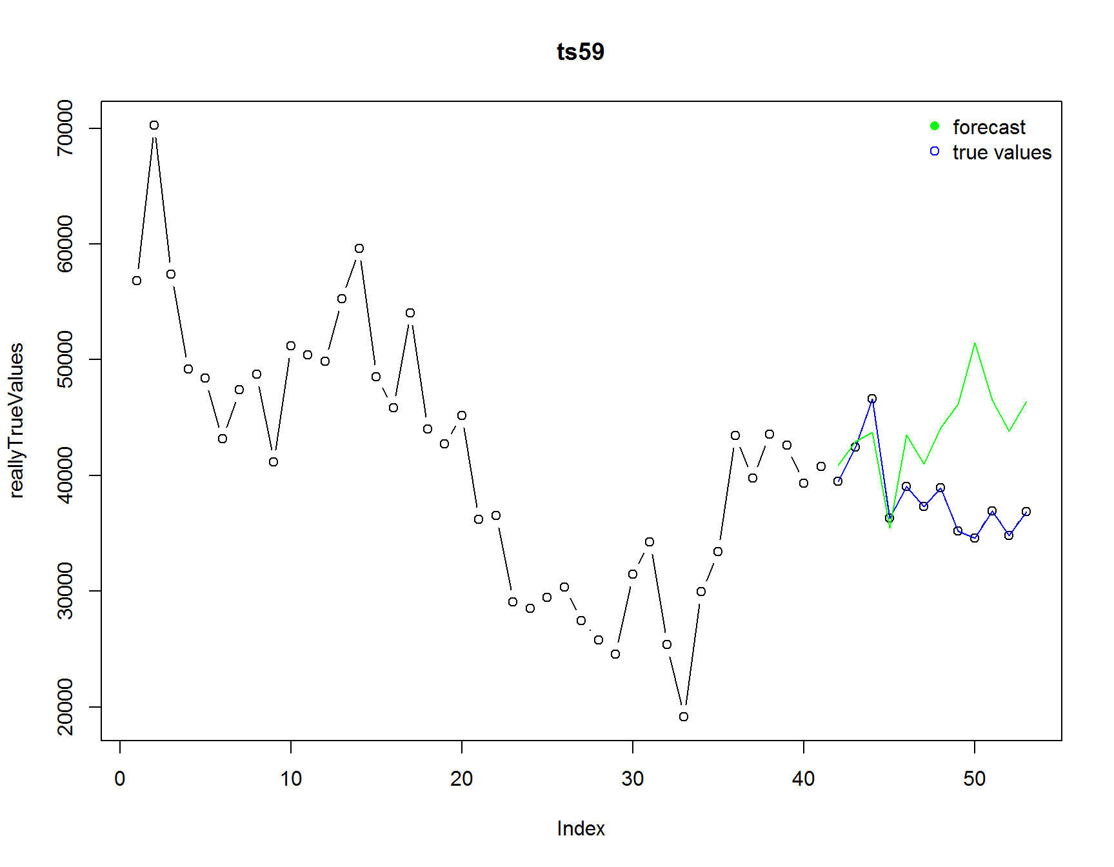
Validation Postprocessing in R

Slide 31
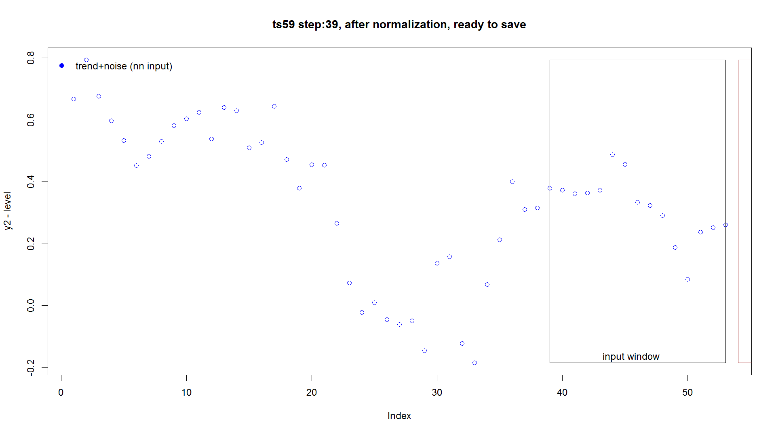
Forecasting
Finally, we train on the validation set running the training with the optimal parameters
The create a new “test” file that contains all the data as inputs. We run the CNTK’s write command on it.
We run postprocessing similar as before and “unwind” the forecast. Done*
*Actually it is more work to do because the data has a small number of very short time series of max horizon=6, and dealing with them doubles the work. Then you have to carefully merge the results ☺

Slide 32
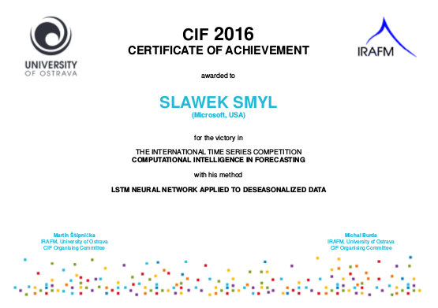
And all what I got for this is:*
*And free beer at a pub near Vancouver Convention Center where WCCI was hosted in July ☺

Slide 33
Questions?

Slide 34
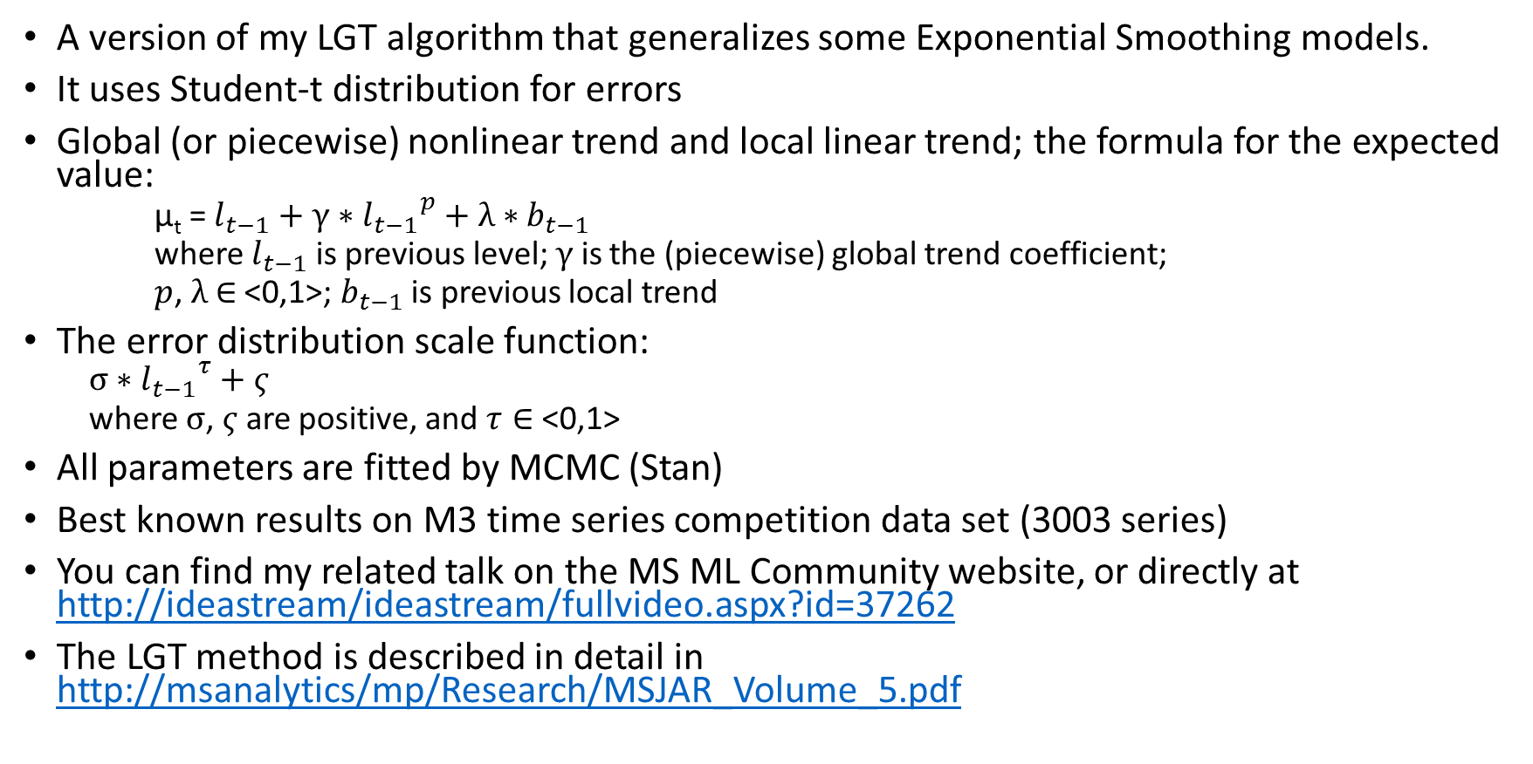
Local and Piecewise Trend (LPT)
A version of my LGT algorithm that generalizes some Exponential Smoothing models.
It uses Student-t distribution for errors
Global (or piecewise) nonlinear trend and local linear trend; the formula for the expected value:
µ_{t} = $l_{t−1}+γ∗{l_{t−1}}^{p}+λ∗b_{t−1}$
where $l_{t−1}$ is previous level; $γ$ is the (piecewise) global trend coefficient;
$p$, $λ$ $∈$ <0,1>; $b_{t−1}$ is previous local trend
The error distribution scale function:
$$σ∗{l_{t−1}}^{τ}+ς$$
where $σ$, $ς$ are positive, and $τ∈$ <0,1>
All parameters are fitted by MCMC (Stan)
Best known results on M3 time series competition data set (3003 series)
You can find my related talk on the MS ML Community website, or directly at http://ideastream/ideastream/fullvideo.aspx?id=37262
The LGT method is described in detail in http://msanalytics/mp/Research/MSJAR_Volume_5.pdf

Slide 35
Further Work – Data Augmentation
NN models tend to have a lot of parameters (weights). To train them, a large data set is required, but often is not available.
In the image recognition area, researchers created methods of “multiplying” the data set size automatically, by rotating a bit the image, changing brightness, adding noise, etc. Similar idea could be applied to time series - after all in statistical view, a time series is considered a random realization of some underlying data generation process.
One way to do this would be to use residuals from a statistical time series algorithm to generate new time series. For Bayesian models fitted with Markov Chain Monte Carlo another approach is obvious: we can sub-sample parameters, residuals, forecasts, etc.
In the recent International Symposium on Forecasting, I and Karthik Kuber, presented a paper on these ideas; more research into it could be very fruitful.

